Slide 1
Keep Calm and Recover: Essential PowerShell(?) Skills for effective incident response remediation
Matthew Hitchcock

Slide 2

Many thanks to our sponsors:

Slide 3


Matthew Hitchcock
Principal Consultant at Mandiant (part of Google Cloud)
Credential Theft Mitigation, Privileged Access and Incident Response Remediation
Co-lead of Mandiant’s Active Directory Security Assessment solution
Former MVP swallowed back into security by trying to solve DevOps blockers!

Slide 4
Goals of the session
Suggest some strategies you can use in recovery scenarios
Spur you into finding better solutions
Give you a feel for the kinds of things you would need to be doing
PowerShell is a Super-Power, not an Attacker Tool!

Slide 5
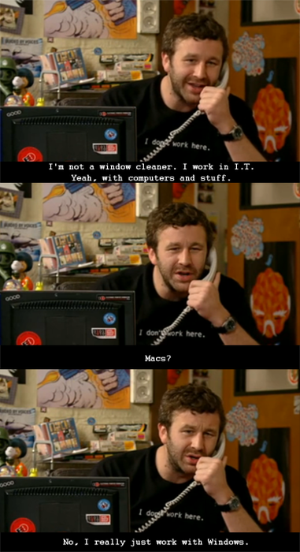
Mandiant STS Team
Proactive – Strengthen Protect, Detect and Response controls through assessments and technical leadership
Reactive – Roll with the Incident Response (IR) team to contain unauthorized activity and remove those parties from networks
Global team of 100+ persons from operations and architecture backgrounds

Slide 6
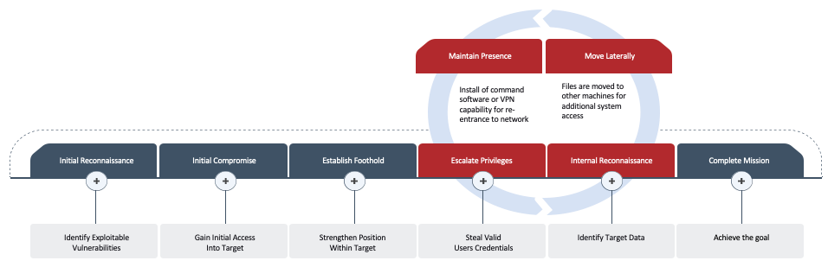
Incident Types and Recovery Frameworks
Advance Persistent Threat (APT)
Ransomware

Slide 7
Goals
Look at some core controls we would want to implement during a containment
Look at some ways that we would want you to work and why
Consider how you would apply these in your environment
Consider if you can start doing some of it now

Slide 8
Taking the Power(Shell) Back – Containment controls
All including DC’s
Enable Windows Firewall
Block incoming connections
Enable Windows Firewall Logging
Enforce Group Policy Reprocessing
Enable PowerShell Logging
Deny known-bad EXEs from communicating out over the network
Deny PowerShell executables from talking to the Internet
Deny communication to known-bad IP addresses
EXCEPT DC’s
Remove PowerShell v2 by start up script **
Deny Local accounts from RDP to endpoints**
Disable the Admin Shares **
Live Demo Environment failed – YouTube demo vide pending
NOTE: DEMO’s BREAK TIER MODEL RULES! DO NOT COPY!

Slide 9
Secure the remote connection
Use IP SEC Authentication to permit specific Admin accounts, from specific machines, for controlled remediation access
Create Block rules with Override Exceptions
Live Demo Environment failed – YouTube demo vide pending
NOTE: DEMO’s BREAK TIER MODEL RULES! DO NOT COPY!
Notes:
IP SEC requests to enable Override rules

Slide 10
Reduce account exposure with Authentication Policies and Silos
Prevent Tier 0 Accounts from logging into anything but Tier 0 Servers
Repeat for Critical Assets
Live Demo Environment failed – YouTube demo vide pending

Slide 11
Prefer Using Remote Administration Tools
Admin Center & Server Manager work over an IP SEC connection if you really need a GUI
Avoid RDP to reduce credential theft risk
Become adept with Invoke-command to run commands in Sessions
https://www.youtube.com/watch?v=RIgoPK3ASUE&pp=ygUJUkRQIGRldmls <- “Is RDP the Devil?” – Joel Platek (IT Candor)
Live Demo Environment failed – YouTube demo vide pending
NOTE: DEMO’s BREAK TIER MODEL RULES! DO NOT COPY!

Slide 12
Think about Enterprise Password Reset exceptions
MFA – Do you trust MFA-registered Devices?
ADCS – Do you have Abusable Certificate Templates with issued certificates?

Slide 13
Server Rebuilds – Clean Source Verification and Patching
Get-FileHash for File verification
Keep a CSV of file hashes in a Git Repo on your PAW – Git will detect changes
Explore KbUpdate module, have a plan for when SCCM, WSUS, BigFix etc. is down. Also, you could have a tried-and-true DSC Template
Use Copy-Item –ToSession to move files in sensitive situations
Live Demo Environment failed – YouTube demo vide pending

Slide 14
Summary
We can harden PowerShell enough to trust it for recovery – don’t disable it
Use Windows Firewall during recovery to get secure communication in place
Prefer Remote Administration tools from a (Tactical) PAW (Privileged Access Workstation) during recovery activities
Validate your checksums when installing software in recovery scenarios. Have an alternative plan for patching!
Check your issued Certificates that may be able to bypass Password Reset work
Explore Authentication Policies and Silos to really block access to your DC’s to not lose time in a Recovery

Slide 15
Q&A
15 minutes

